Slide 1







RESTAURANT RESERVATION SYSTEM
Group Name: Zero 1
Group ID: 10
Lab Section: 1B

Slide 2


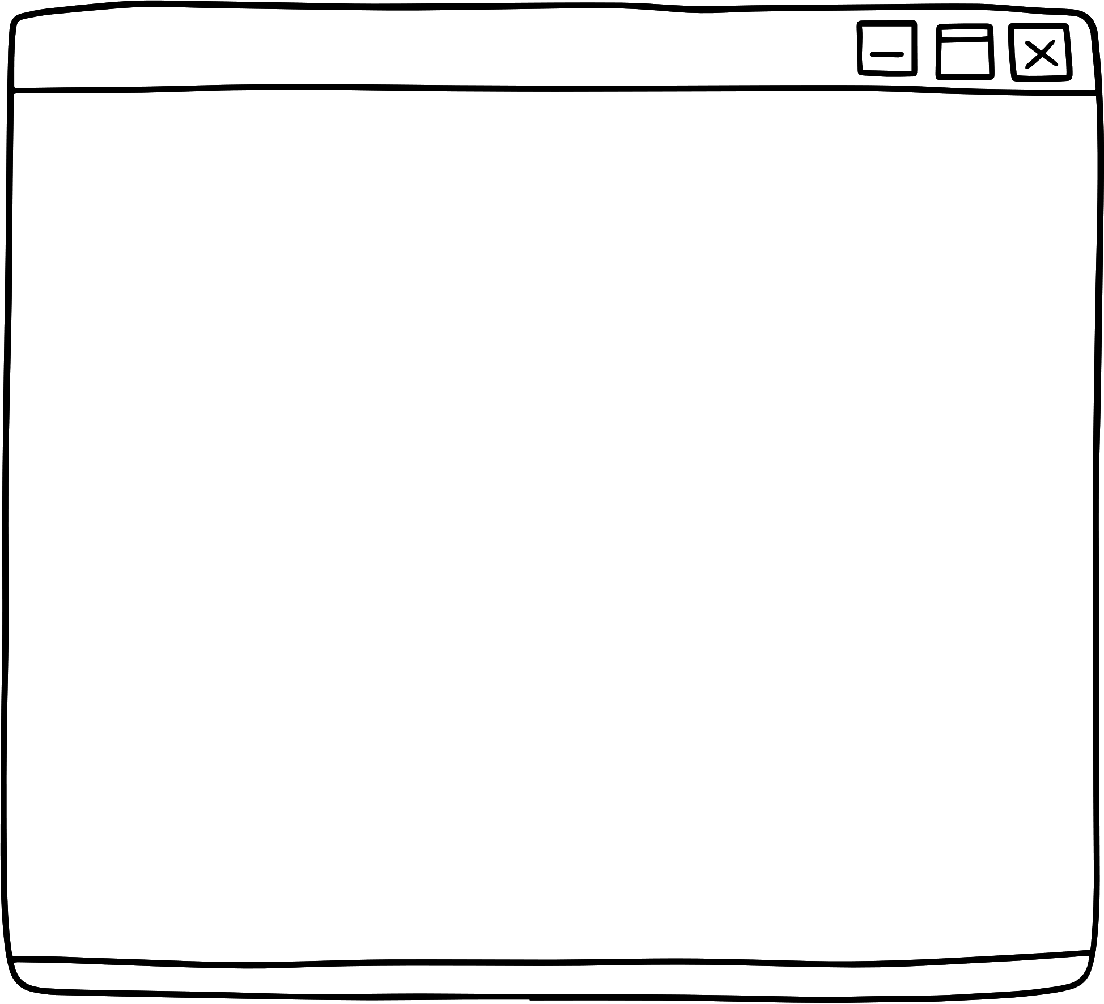





THE TEAM
Tan Wei Chuen
Brandon Tan Chi Hong
Lee Chuan Tiew
Justin Lau Li Ting

Slide 3


INTRODUCTION
STEP 1
Discuss & Analysis
Purpose: Revolutionize restaurant reservations with C++ technology.
For Customers: Easy, efficient table booking.
For Managers: Streamlined real-time table and reservation management.
Key Features: Scalable, adaptable, integration-ready.
Impact: Boosts efficiency, enhances customer experience, future-ready.
STEP 2
Complete the code in C++
STEP 3
Test and fix error/bug

Slide 4



INDUSTRY CHALLENGE:
Inefficiency and revenue loss due to lack of integrated reservation systems.
PROBLEM STATEMENT
CURRENT LIMITATIONS:
Reliance on manual processes or costly third-party platforms.
CUSTOMER EXPERIENCE GAP:
Difficulty in planning dining experience effectively.

Slide 5





SIMPLIFY THE BOOKING FLOW :
Condense the reservation process into a few intuitive steps for quick and easy booking.
OBJECTIVE
DESIGN FOR CLARITY :
Create a user-friendly interface with clear, concise instructions, enhancing the customer's journey from selection to reservation.
CLOSE THE EXPERIENCE GAP:
Ensure the system bridges the customer experience gap, facilitating a seamless dining planning process.

Slide 6

IMPLEMENTATION DETAILS
Data Structures
Vector: Chosen for its ability to handle dynamic size changes, essential for reservation management.
Queue: Utilised in `SortReserve` for storing sorted results in ascending order, in line with FIFO principle.
Stack: Employed in `SortReserve` to store sorted results in descending order, leveraging the LIFO principle.
Searching and Sorting Algorithms
Searching Algorithm: Linear Search (`SearchReserve`): Effective for searching reservations by booking ID, suitable for the expected dataset size.
Sorting Algorithm: QuickSort (`sort_by_name_partition` and `sort_by_name`): Chosen for sorting reservations by customer name due to its efficiency in large datasets and in-place sorting feature.

Slide 7



Special Features
Dynamic Array Functionality for Reservations: Using `vector` for reservation data (`rsvt_data`) to allow dynamic modifications.
Data Persistence: Implementing File I/O operations (`loadData` and `saveData`) for loading and saving reservation data to "booking.txt".
Unique ID Management: Applying static variables in `getNewId` and `getLastId` to ensure unique IDs for each reservation.
IMPLEMENTATION DETAILS

Slide 8

TASK DISTRIBUTION TABLE
NAME | Programming Tasks | Report Tasks | Presentation Tasks
Lee Chuan Tiew | Code integration & data management | Program Screenshot | Demo Video preparation
Justin Lau Li Ting | Add/cancel data coding & error resolution | Documentation Compilation & report review | PowerPoint completion & materials check
Tan Wei Chuen | Program discussion & feature completion | ADT Specification | Presentation prep & leader-directed tasks
Brandon Tan Chi Hong | Code editing, sorting & debugging | Implementation Details | Slide preparation & review

Slide 9
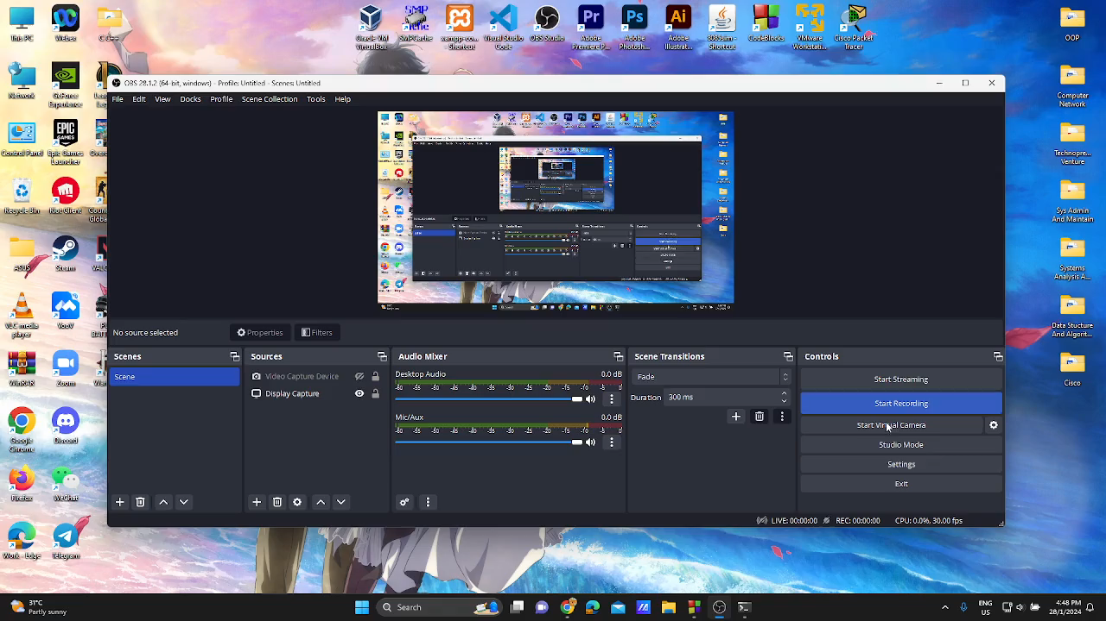
DEMONSTRATION

Slide 10
THANK YOU

